Slide 1
Midterm Topics (this Friday, Feb. 20)
1. Scientific units, notations
2. Exponents, trigonometry
3. Length scales in the universe, astronomy units
4. Eratosthenes: radius of the Earth
5. Earth’s axis tilt, seasons, precession
6. Important stars and constellations
7. Kepler’s Laws
8. Galileo’s & Newton’s contributions
9. Newton’s laws
10. Conservation laws: Energy, momentum, angular momentum
11. Kinetic & Potential Energy

Slide 2
Midterm Topics (this Friday, Feb. 20)
12. Gravity
13. Circular Motion
14. Escape velocity
15. Tides
16. Electromagnetic waves
17. Electromagnetic spectrum
18. Blackbody radiation
19. Photons
20. Electronic structure of atoms
21. Spectroscopy
22. Doppler effect
23. Nuclear particles
24. P-P chain solar fusion
1. Scientific units, notations
2. Exponents, trigonometry
3. Length scales in the universe, astronomy units
4. Eratosthenes: radius of the Earth
5. Earth’s axis tilt, seasons, precession
6. Important stars and constellations
7. Kepler’s Laws
8. Galileo’s & Newton’s contributions
9. Newton’s laws
10. Conservation laws: Energy, momentum, angular momentum
11. Kinetic & Potential Energy

Slide 3
Formula Sheet

Slide 4
Midterm Format
4 questions (or if two are really easy then 5 questions).
Formula sheet will be included in test.
Mix of quantitative and qualitative questions.
Time: 9 am – 9:50 am.
Write legibly. Points will be taken off for messy and unreadable test answers.

Slide 5
Midterm Rules
Closed book test.
No internet searches ... No internet usage.
No artificial intelligence assistance.
No computers
No phones
No use of course website, Blackboard course notes, or OpenStax Astronomy book.
Calculator recommended (with trig functions).

Slide 6
Today’s Topics
Monday, February 16, 2026 (Week 4, lecture 11) – Chapter 5.
A. Doppler effect -- continued
B. Nuclear particles
C. Nuclear Isotopes
D. Solar fusion
REMINDER #1: Problem Set #4 is due on ExpertTA by Wednesday, February 18, 9:00 AM.
REMINDER #2: Midterm #1 is on Friday, February 20.

Slide 7
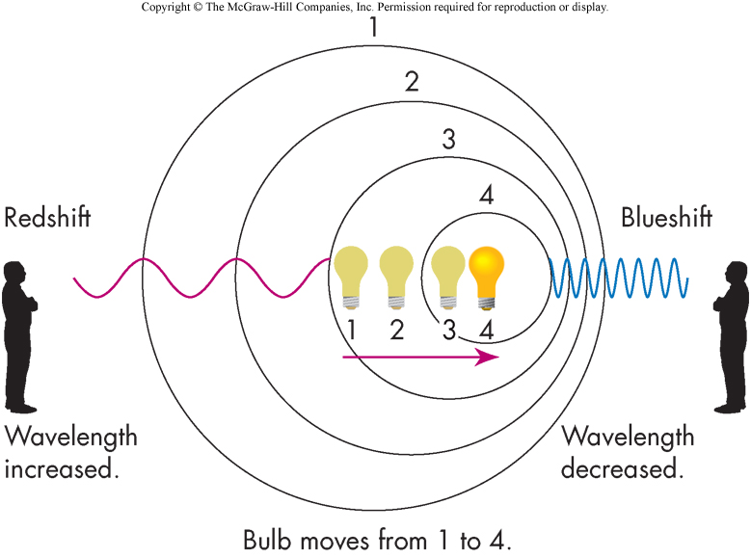
Doppler Effect
A moving source cannot change the speed of its emitted light, but it does change its frequency & wavelength.
v
frequency
decreases
frequency
increases
[image source: J. Nelson]

Slide 8


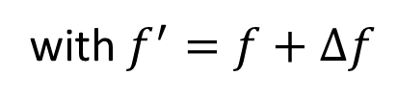
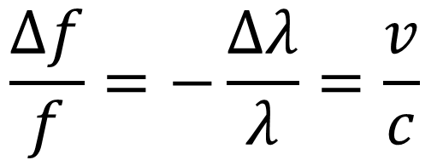
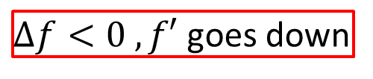

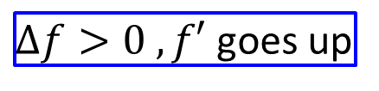

Doppler Shift Calculation
$$\frac{∆f}{f}=−\frac{∆λ}{λ}=\frac{v}{c}$$
Doppler frequency shift:
with $f^{′}=f+Δf$
frequency of stationary source
perceived frequency of moving source
If source is moving towards you, then light is blue shifted.
$$v>0$$
$Δf>0 , f′$goes up
$$Δλ<0$$
If source is moving away from you, then light is red shifted.
$$v<0$$
$Δf<0 , f′$goes down
$$Δλ>0$$

Slide 9
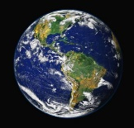

Doppler Shift
is for
Line-of Sight Velocity Component
$$v$$
star’s travel direction
line-of-sight
Earth
star
OpenStax; R. Stockli, A. Nelson, F. Hasler, NASA/GSFC/NOAA/USGS)

Slide 10

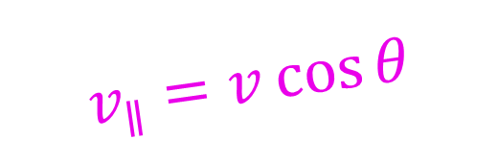
Doppler Shift
is for
Line-of Sight Velocity Component
$$v$$
star’s travel direction
$$θ$$
line-of-sight
Earth
$$v_{∥}=v\cos{θ}$$
star
OpenStax; R. Stockli, A. Nelson, F. Hasler, NASA/GSFC/NOAA/USGS)

Slide 11




Doppler Shift
is for
Line-of Sight Velocity Component
$$v$$
star’s travel direction
$$θ$$
line-of-sight
Earth
$$v_{∥}=v\cos{θ}$$
star
Doppler frequency shift:
$$\frac{∆f}{f}=−\frac{∆λ}{λ}=\frac{v_{∥}}{c}$$
OpenStax; R. Stockli, A. Nelson, F. Hasler, NASA/GSFC/NOAA/USGS)

Slide 12





Doppler Shifts for Rotating Sources
$$v_{rotation}$$
blue shifted
$$λ^{′}=λ−∆λ$$
rotating star
no shift
$$λ^{′}=λ$$
red shifted
$$λ^{′}=λ+∆λ$$
$$v_{rotation}$$

Slide 13
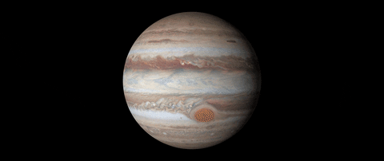
Doppler Shifts for Rotating Sources
$$v_{rotation}$$
blue shifted
$$λ^{′}=λ−∆λ$$
rotating star
no shift
$$λ^{′}=λ$$
red shifted
$$λ^{′}=λ+∆λ$$
$$v_{rotation}$$
blue shifted
red shifted
[NASA, giphy]

Slide 14
Doppler Shifts for Rotating Sources
$$v_{rotation}$$
blue shifted
$$λ^{′}=λ−∆λ$$
rotating star
no shift
$$λ^{′}=λ$$
red shifted
$$λ^{′}=λ+∆λ$$
$$v_{rotation}$$
slow
blue shifted
fast
red shifted
slow
[NASA, giphy]

Slide 15
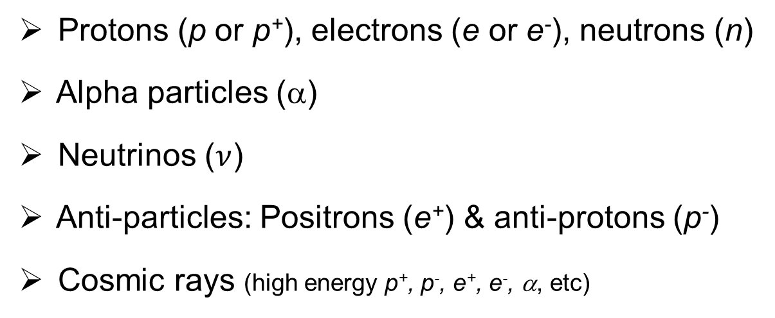
Nuclear Particles
Photons are the easiest particles with which to view space, but they are not the only ones
Protons (p or p⁺), electrons (e or e⁻), neutrons (n)
Alpha particles (α)
Neutrinos ($ν$)
Anti-particles: Positrons (e⁺) & anti-protons (p⁻)
Cosmic rays (high energy p⁺, p⁻, e⁺, e⁻, α, etc)

Slide 16

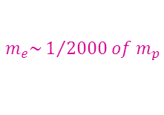
Particle Properties
Particle | Mass (kg) | Electric charge | Forces
Proton | 1.67265 × 10⁻²⁷ | +1 | Strong, EM, weak, gravity
Neutron | 1.67495 × 10⁻²⁷ | 0 | Strong, weak, gravity
Electron | 9.11 × 10⁻³¹ | -1 | EM, weak, gravity
Neutrino | < 2 × 10⁻³⁶ | 0 | weak, gravity
$$m_{n}\sim m_{p}$$
$$m_{e}\sim 1/{2000 of m_{p}}$$
barely interacts with anything !!! (very hard to detect)

Slide 17
Particle Properties
Particle | Mass (kg) | Electric charge | Forces
Proton | 1.67265 × 10⁻²⁷ | +1 | Strong, EM, weak, gravity
Neutron | 1.67495 × 10⁻²⁷ | 0 | Strong, weak, gravity
Electron | 9.11 × 10⁻³¹ | -1 | EM, weak, gravity
Neutrino | < 2 × 10⁻³⁶ | 0 | weak, gravity
$$m_{n}\sim m_{p}$$
$$m_{e}\sim 1/{2000 of m_{p}}$$
barely interacts with anything !!! (very hard to detect)
Fundamental forces
There are only 4 fundamental forces that we know of:
Strong nuclear force, electromagnetic force, weak nuclear force, gravity.
(holds nucleus together)
(generates radioactive decay)
(very very weak)
[short range]
[short range]

Slide 18
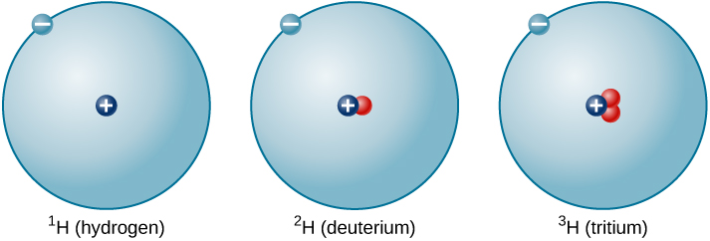
Nuclear Isotopes: hydrogen
Number of neutrons affects the properties of nucleus, but not chemistry.
3 hydrogen isotopes:
e⁻
p
n
(stable)
“heavy hydrogen”
(unstable: 12 year half-life)
(stable)
[OpenStax: Astronomy]

Slide 19


Nuclear Isotopes: helium
2 stable isotopes of helium:
e⁻
n
+
+
+
+
p
-
-
³He
⁴He
[OpenStax: Astronomy]
1 neutron
2 protons
2 neutron
2 protons
Note: an alpha particle (α) is a helium-4 nucleus
+
+

Slide 20


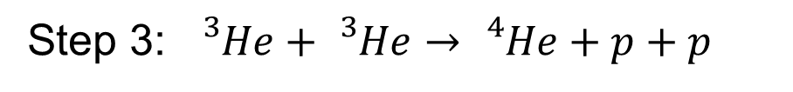
Solar Fusion
Proton-proton chain
Step 1: $p+p→{}_{}^{2}H+e^{+}+ν$
+ energy
Step 2: ${}_{}^{2}H+p→{}_{}^{3}{He}+γ$
+ energy
Step 3: ${}_{}^{3}{He}+{}_{}^{3}{He}→{}_{}^{4}{He}+p+p$
+ energy

Slide 21
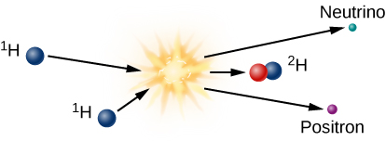

Step 1: p + p
Step 1: $p+p→{}_{}^{2}H+e^{+}+ν$
+ energy of 1.442 MeV
weak force
Note: 1 eV = 1.602 × 10⁻¹⁹ J
Note: This reaction is very slow … protons are estimated to wander around for 9 billion years (on average) in Sun’s core before this process occurs.

Slide 22
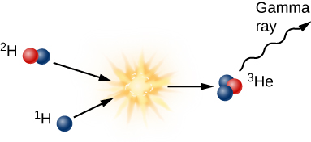

Step 2: ²H + p
Step 2: ${}_{}^{2}H+p→{}_{}^{3}{He}+γ$
+ energy of 5.49 MeV
strong force
Note: This reaction is very fast … each ²H nucleus lasts about 4 seconds.

Slide 23
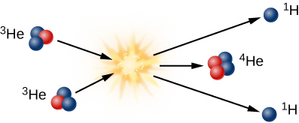
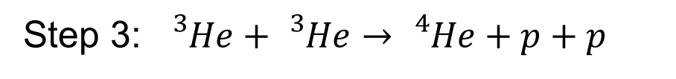
Step 3: ³He + ³He
Step 3: ${}_{}^{3}{He}+{}_{}^{3}{He}→{}_{}^{4}{He}+p+p$
+ energy of 12.86 MeV
strong force
Note: each helium-3 nucleus lasts about 400 years in the Sun’s core.

Slide 24
Summary of proton-proton chain
2 × 1.442 MeV
+
2 × 5.49 MeV
+
12.86 MeV
= 26.7 MeV total
= 4.28 × 10⁻¹² J
By Sarang - Own work, Public Domain, https://commons.wikimedia.org/w/index.php?curid=51118538

Slide 25
Charged Particle Astronomy
Protons and electrons (and anti-protons & positrons) + α-particles
Good: lots of them, easy to detect (in space).
→ Stars emit p+ and e- as solar wind.
→ Cosmic rays from violent stellar events.
(charge = +2)

Slide 26
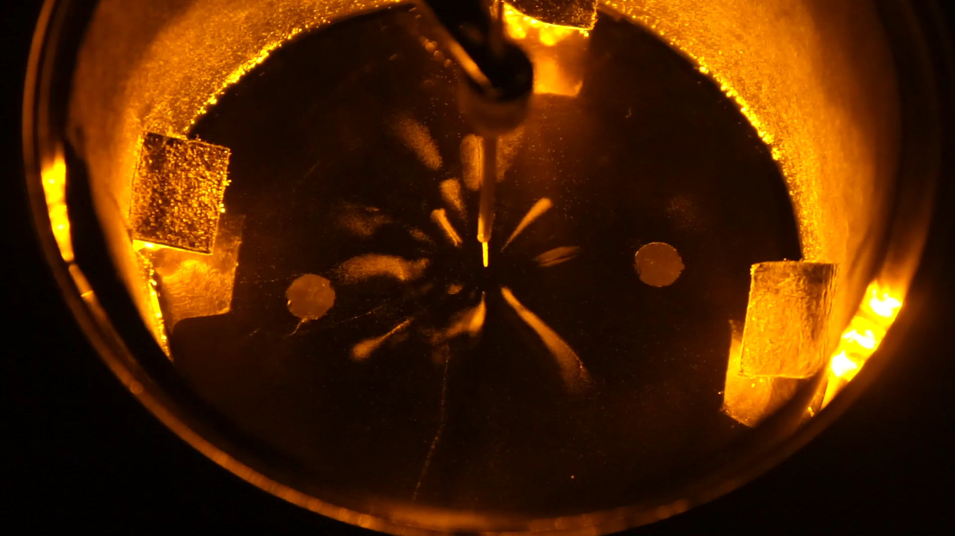
Alphas, electrons, muons
from radioactive Lead-210
(muon = heavy electron)
Cloud Chamber
[video by Megan Frayser, W&M 2019]

Slide 27
Alphas, electrons, muons
from radioactive Lead-208
(muon = heavy electron)
electron
muon
or fast electron
alpha
or proton
[photos by Megan Frayser, W&M 2019]

Slide 28
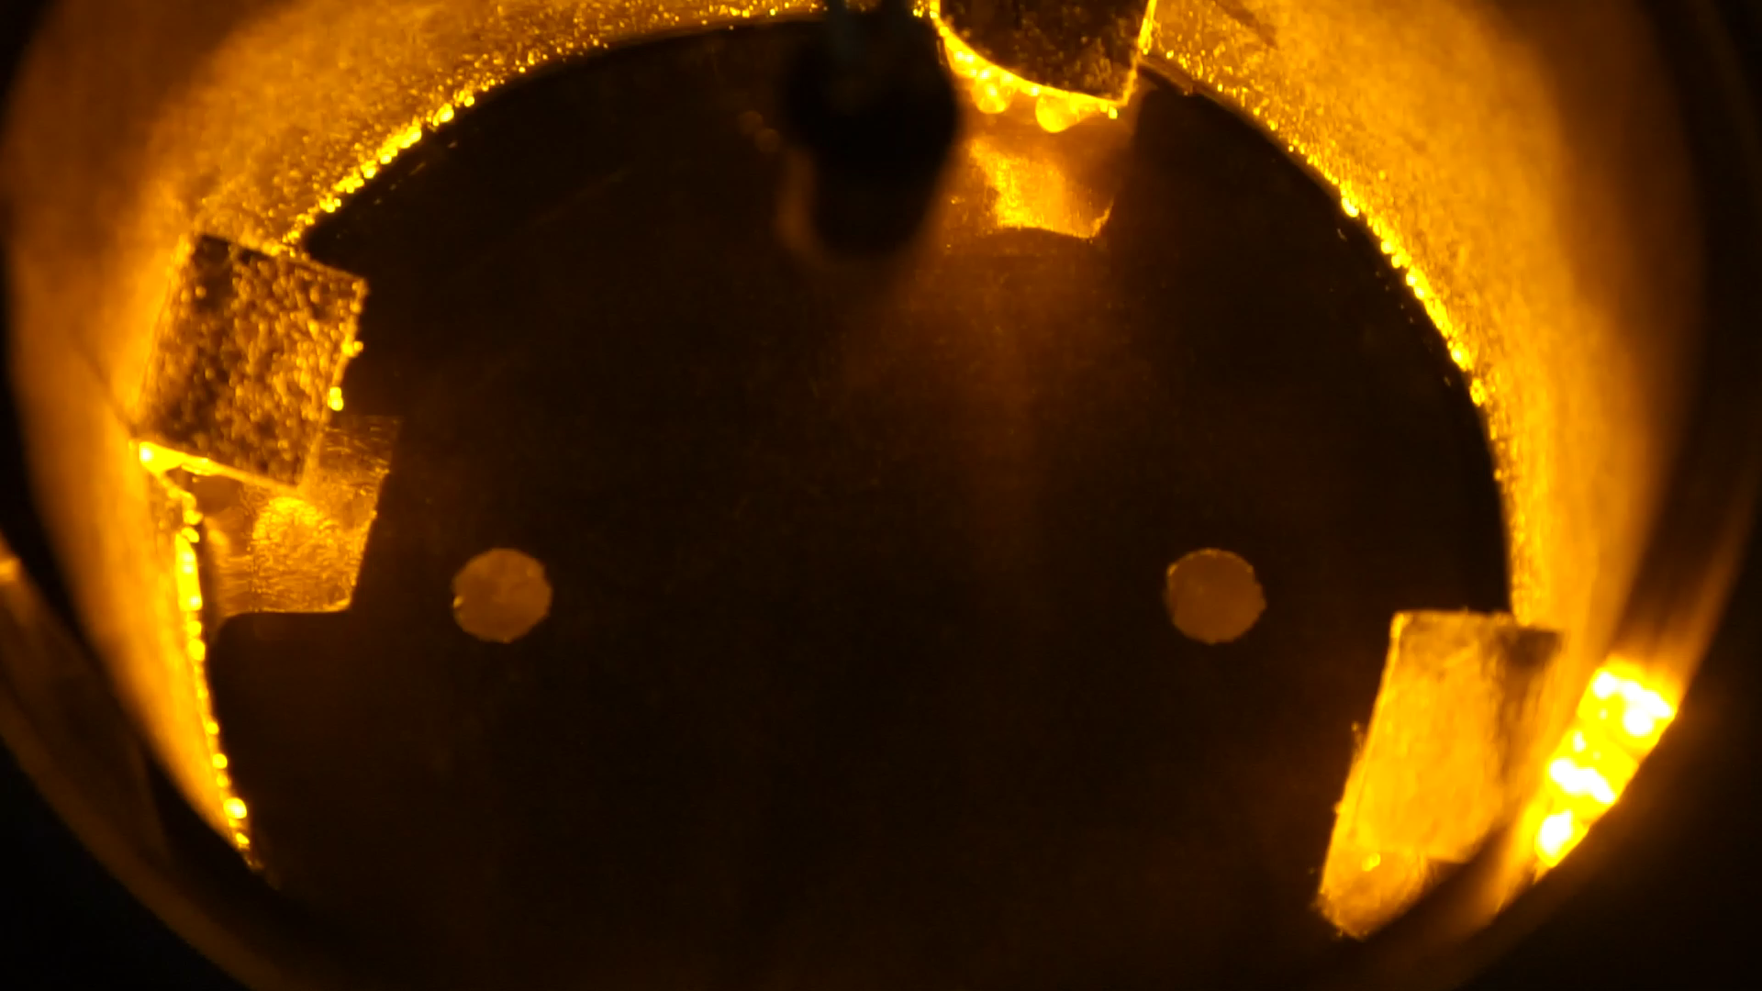
Alphas, electrons, muons
from background cosmic rays & radioactivity
(muon = heavy electron)
Cloud Chamber
[video by Megan Frayser, W&M 2019]

Slide 29
Charged Particle Astronomy
Protons and electrons (and anti-protons & positrons) + α-particles
Good: lots of them, easy to detect (in space).
→ Stars emit p+ and e- as solar wind.
→ Cosmic rays from violent stellar events.
(charge = +2)

Slide 30
Charged Particle Astronomy
Protons and electrons (and anti-protons & positrons) + α-particles
Good: lots of them, easy to detect (in space).
→ Stars emit p+ and e- as solar wind.
→ Cosmic rays from violent stellar events.
Bad: Strongly affected by planetary, solar, and galactic magnetic fields.
→ Hard to identify origin/source of particle.
(charge = +2)
anti-proton (p⁻)
magnetic
field
Particle does not “point back” to its origin.
→ not useful for imaging.
proton (p⁺)

Slide 31
What are anti-particles ?
Antiprotons are protons with negative charge (q=-1).
Positrons (anti-electrons) are electrons with positive charge (q=+1).
Antineutrons are neutrons with opposite magnetic moment.

Slide 32
What are anti-particles ?
Antiprotons are protons with negative charge (q=-1).
Positrons (anti-electrons) are electrons with positive charge (q=+1).
Antineutrons are neutrons with opposite magnetic moment.
Antimatter
You can build nuclei and atoms using antiprotons, positrons, and antineutrons.
Anti-hydrogen consist of an anti-proton + positron.
→ Anti-hydrogen still feels attractive gravity.
Anti-helium consists of anti-alpha particle + 2 positrons.
(charge = -2)

Slide 33
What are anti-particles ?
Antiprotons are protons with negative charge (q=-1).
Positrons (anti-electrons) are electrons with positive charge (q=+1).
Antineutrons are neutrons with opposite magnetic moment.
Antimatter
You can build nuclei and atoms using antiprotons, positrons, and antineutrons.
Anti-hydrogen consist of an anti-proton + positron.
→ Anti-hydrogen still feels attractive gravity.
Anti-helium consists of anti-alpha particle + 2 positrons.
(charge = -2)
Matter-Antimatter Annihilation
When matter and antimatter meet they annihilate each other to ultimately produce gamma rays and neutrinos.
e⁻+e⁺

